Slide 1
Assignment 2 – Computer Vision Classification of Images through BoVW
Objectives
Develop a complete system for the classification of aerial images (21 classes) acquired by RGB cameras. Use a Bag-of-Visual-Words approach: A vocabulary of K visual words is trained from local descriptors (SIFTs or ORBs). Then each image will be represented by a visual vector. The size of this vector depends on the size of the vocabulary. The vectors obtained, for different vocabularies, are used to train different classifiers. Determine:
The behavior of the system as K varies (50, 100, 500) and select the most convenient value (mandatory) The best classifier (required) the best local features between SIFT and ORB (optional)
Dataset
To learn the vocabulary of visual words, images from the AID (Aerial Image Dataset) dataset were used The UC Merced Land Use Dataset is used to train classifiers
Gabriele Lo Cascio

Slide 2
Introduction
A feature is a numerical representation extracted from an image with the goal of capturing information for a specific task. The general idea of bag of features is to represent an object (text, image) as a histogram of features. In the case of textual documents: bag of words. The extracted features are the atomic units of which the documents are composed: the words. In particular, each document is represented by a vector of which each component indicates the frequency of a word, i.e. how many times it appears. The sum of all words is in fact a vocabulary. In the case of images: bag of visual words. The atomic units of which images are composed are not constrained a priori, as in the case of text, by a particular language. Consequently, in order to construct the vocabulary, it is necessary to determine these atomic units, i.e. the visual words. Starting from a collection of images, the first step is the extraction of local features from each image, this can be done with any approach. At this point, for each image you get a set of vectors that describe it. The second step consists in merging the vectors of all the images together and then carrying out a quantization. This means that a narrow set of representative vectors will be chosen: visual words. This can be done, for example, by clustering. Therefore, we can describe a new image in terms of the visual words identified. Local features are extracted from the image and each feature is assigned to the closest visual word. Then you calculate the frequency of appearance of each of the visual words. We will have that each image will be represented by a frequency histogram (visual vector).

Slide 3
Analysis of the AID dataset
The vocabulary is built by considering the AID dataset. In particular, for each image, the SIFT descriptors are extracted: descriptors invariant to variations in scale and orientation. Each SIFT descriptor is a vector of 128 components. This choice is supported by [1]: "... An in-depth comparison with other local descriptors showed that this descriptor obtained the best results in an image matching task". It has been noted that for each image a variable number of descriptors (between 0 and 4000) is identified, this is due to the different properties of each image. So, after converting the image to grayscale and applying the algorithm to derive the SIFTs, the risk is not being able to extract any features. Furthermore, by collecting the features for each image and grouping for each of the 30 classes of the dataset, a strong imbalance in the number of descriptors for each class was observed. In particular, the 'Desert' class is on average the minority, while the 'Viaduct' class is the average majority. At present, therefore, there are two problems: Unbalance of the number of features for each class (quantization will have a bias against classes with multiple samples) Failed feature extraction (crucial in the inference phase, since classification cannot be performed if the extraction step fails)

Slide 4
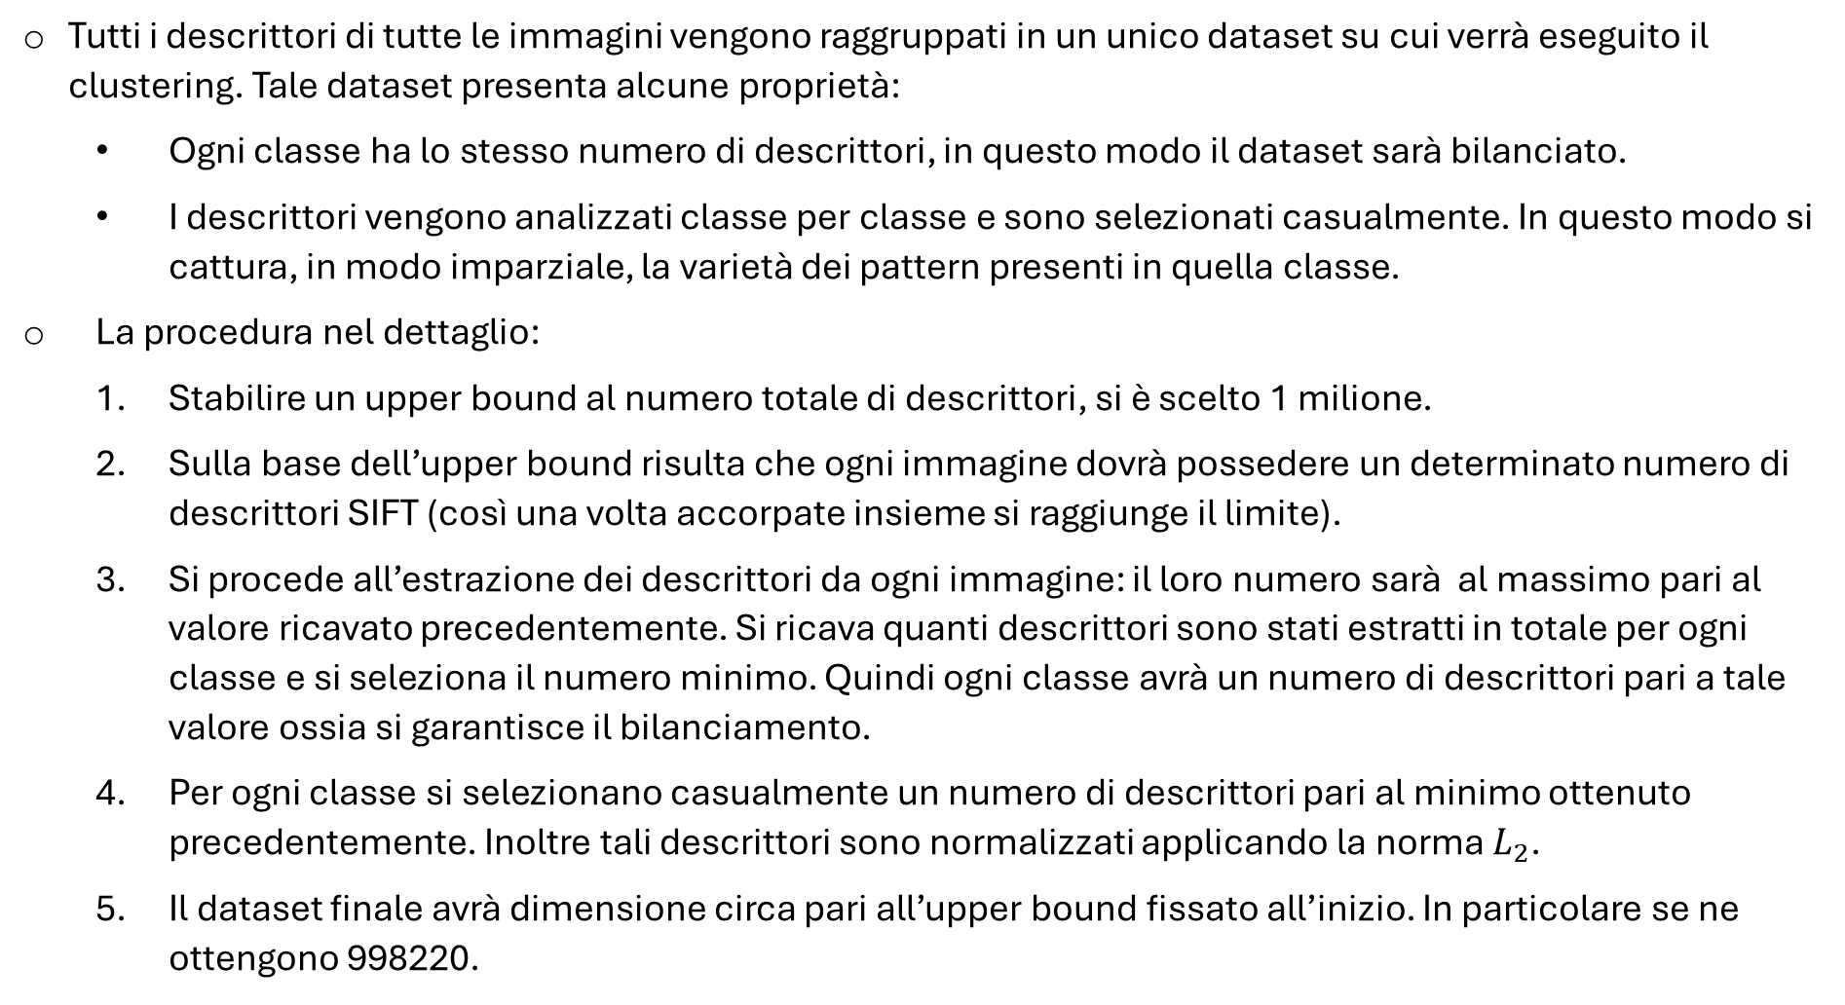
The procedure – local features and balancing
All descriptors of all images are grouped into a single dataset that will be clustered. This dataset has some properties: Each class has the same number of descriptors, so the dataset will be balanced. The descriptors are analyzed class by class and are randomly selected. In this way, the variety of patterns present in that class is captured, in an unbiased way. The procedure in detail: To establish an upper bound to the total number of descriptors, 1 million was chosen. On the basis of the upper bound, it appears that each image must have a certain number of SIFT descriptors (so once merged together the limit is reached). The descriptors are extracted from each image: their number will be at most equal to the value obtained previously. You get how many descriptors have been extracted in total for each class and select the minimum number. So each class will have a number of descriptors equal to this value, i.e. balancing is guaranteed. For each class, a number of descriptors equal to the minimum obtained previously are randomly selected. In addition, these descriptors are standardised by applying the L_2 standard. The final dataset will be about equal in size to the upper bound set at the beginning. In particular, 998220 are obtained.

Slide 5
The procedure – preprocessing e features extraction
The steps seen above, for the construction of the descriptor dataset, are heavily guided by the initial phase of feature extraction. In addition, as mentioned above, this phase also influences inference. Having an image for which no SIFTs are derived is equivalent to having a text document without words. In the absence of features that describe the object, the bag of features approach cannot be applied. As a result, no classification can be made, and even the best classifier will be useless if it cannot be used. The solution to this problem is to employ a technique that has already demonstrated its potential in the previous assignment: PCA. In fact, each point of the image is initially a vector of three components (BGR), so the direction of maximum variance of these points can be obtained and the value of the projection along that direction can be associated as an intensity value to each point. It was noted that, by applying this technique, it is possible to extract features even from images for which SIFTs were not detected. Using this technique, it is possible to detect descriptors for each image of both datasets (AID and UC Merced). At this point, both problems are solved: abundance of features and balanced final dataset.

Slide 6
The procedure – codebook
After building the balanced and overall dataset of all the descriptors, we proceed to carry out the quantization. In particular, the K-means algorithm is applied considering the following values of K: 50, 100, 500. These centroids obtained constitute the visual words. Retracing the parallelism with textual documents, a large vocabulary implies having a large number of words that can be associated with each document. For example, supposing that you limit your vocabulary to only words belonging to a certain field, you are not able to capture documents from different classes. In the same way, by limiting the vocabulary to words belonging to a particular register, perhaps it will be possible to characterize documents belonging to different classes but without a specific granularity. The same reasoning applies to images. Since the dataset has been balanced taking into account the various classes, the idea is that a greater number of visual words can describe an image in greater detail. As a result, the classification is also expected to be more precise. At the end of this phase, starting from the balanced dataset of size 998220x128, three codebooks will be produced relating to the three values of K: the first of size 50x128, the second 100x128 and the third 500x128. At this point, we consider the UC Merced dataset. In fact, the codebooks produced (starting from AID) are used to describe the images of this dataset. In particular, three datasets will be produced, each for each codebook, which will subsequently be used to train the classifiers: The first is 2100x50, the second 2100x100 and the third 2100x500. Where 2100 are the images contained in UC Merced. Furthermore, as reported in [1], the visual vectors obtained are normalized by means of a L_1 standard "to take into account the difference in the number of points of interest between the images".

Slide 7
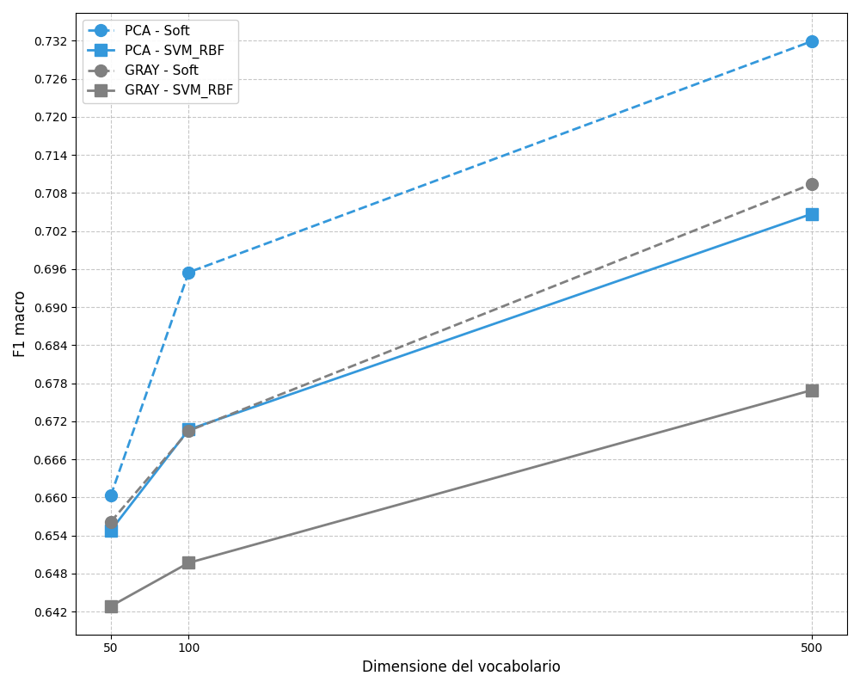
Classification
A 3-fold cross-validation is used, taking care that the folds created are balanced with respect to the samples per class. All the types of classifiers among those indicated for the assignment are considered. The hyperparameters that are specified were obtained after a few manual training attempts. Here's how to train for a given model: Hyperparameters are fixed. A clone of the model is trained for each fold, obtaining three different classifiers. However, the same initial set of hyperparameters allows us to merge together the predictions obtained independently on the three folds. At the end of the 3-fold there will be predictions on the entire train set. F1 score and AUC are calculated. A note of color regarding the classifier called "Soft": it is a Voting Classifier. Random Forest, SVM linear, SVM rbf meet. In addition, the vote of each classifier has the same weight. This choice is motivated by the fact that, to obtain heterogeneous classifiers, very different algorithms are used. This increases the likelihood that they will make very different types of errors, improving the accuracy of the ensemble [5]. The table with the top 10 classifiers is shown below.
Comparison of the best models obtained, single and ensemble, for the two preprocessing techniques. In both cases, the codebook was built from about one million SIFT descriptors. With the same K, an incremental increase in performance from +1% to +3% is observed between the single model and the ensemble.
K | modello | F1 macro | auc macro
500 | Soft | 0.732 | 0.975
500 | SVM RBF | 0.705 | 0.971
100 | Soft | 0.696 | 0.969
500 | SVM Linear | 0.678 | 0.968
100 | SVM RBF | 0.671 | 0.968
500 | Random Forest | 0.668 | 0.962
100 | Random Forest | 0.667 | 0.960
500 | Logistic Regr | 0.666 | 0.956
50 | Soft | 0.660 | 0.965
50 | SVM_RBF | 0.655 | 0.962

Slide 8
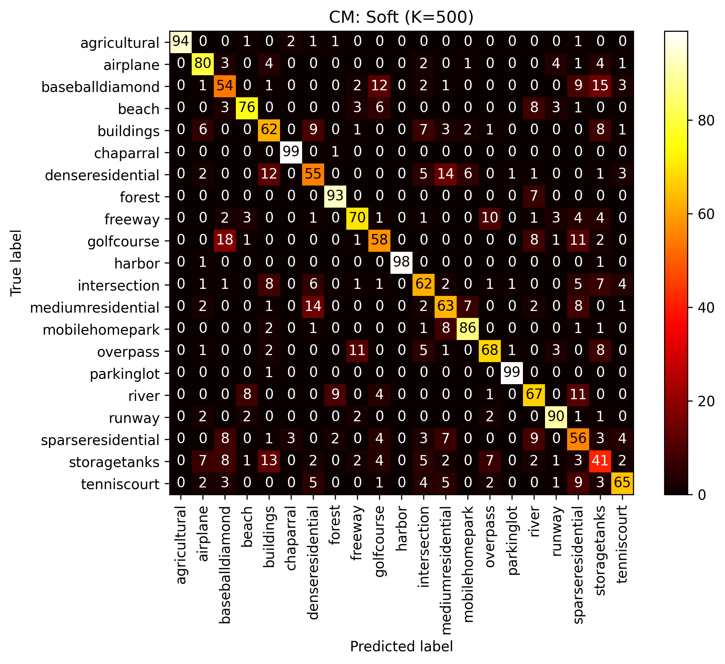
Better Model Metrics and Analysis
The UC Merced dataset has an intrinsic balance (100 samples per class), so F1 score is calculated in macro mode. The same goes for AUC (area under the curve). The F1 metric is the harmonic average between precision and recall, so you will only get a high F1 score if both are relevant and similar. The AUC is the area subtended by the curve obtained from the plot between false positive rate and true positive rate. A linear trend will be equivalent to a random classifier, i.e. the rate of false positives is the same as true positives. In this case, the area under it will be 0.5. For the most confident classes, there is a correctness rate ≥70%. The "storagetanks" class is identified in only 41% of cases. For the less confident classes, there is a rate between 54%-69%. Often, despite the class being incorrect, the macro category is correct: "denseresidential" with "buildings" and "mediumresidential".
Confusion matrix related to the ensemble. clf1 = SVC(kernel="linear", probability=True, class_weight="balanced", random_state=177) clf2 = RandomForestClassifier(n_estimators=500, class_weight="balanced", random_state=177) clf4 = SVC(kernel="rbf", probability=True, C=10.0, class_weight="balanced", random_state=177) clf6 = VotingClassifier(voting='soft', estimators=[('svm_lin', clf1), ('svm_rbf', clf4), ('rf', clf2)])

Slide 9
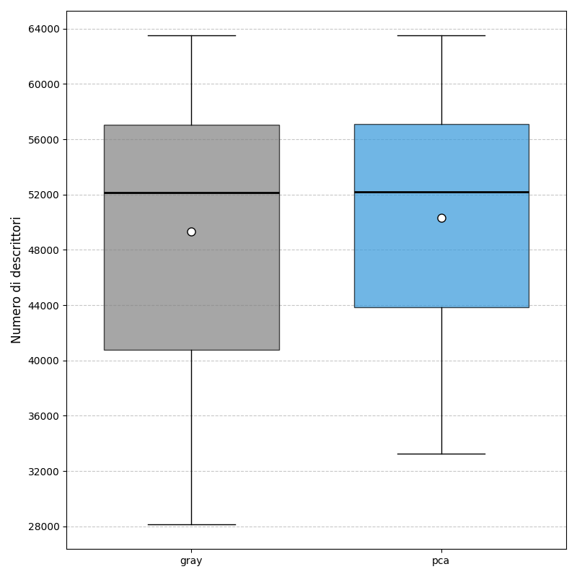
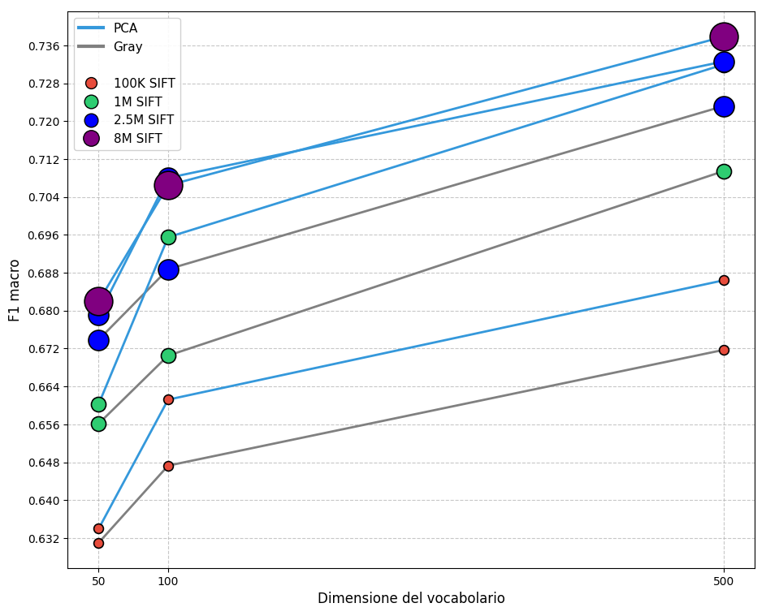
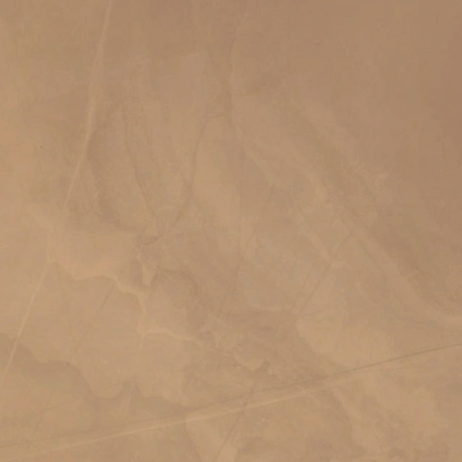
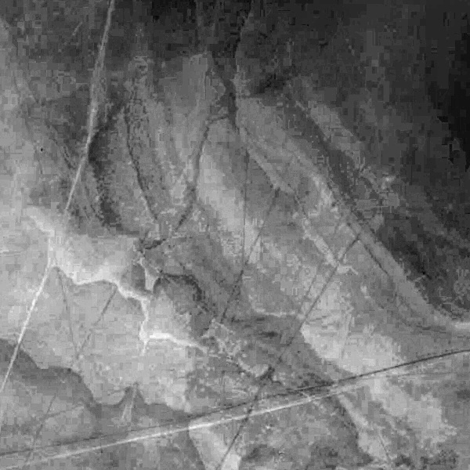
Insight Charts
Distribution of the number of descriptors for each class of the AID dataset and for the two preprocessing techniques.
Performance of the "Soft" model as the size of the vocabulary varies and for the different preprocessing techniques used. Vocabularies built from a different number of SIFTs are also reported. With the same preprocessing and vocabulary size, you will see an increase in model performance if the codebook has been built by clustering on a larger number of SIFTs. A possible explanation could be that in a high-dimensional space, a large number of vectors, i.e. less sparsity, is required to ensure better robustness of the K-means centroids. Note that 2.5M is the maximum number of features that could be extracted by applying grayscale conversion and keeping the classes balanced. While applying PCA even 8M features were obtained, achieving better results but not significantly. To limit the computational load 1M is the optimal choice.
Image desert_11 of the AID dataset. (no SIFT)
Image converted by applying PCA.

Slide 10
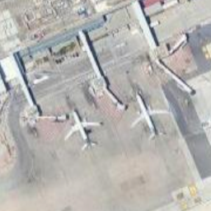
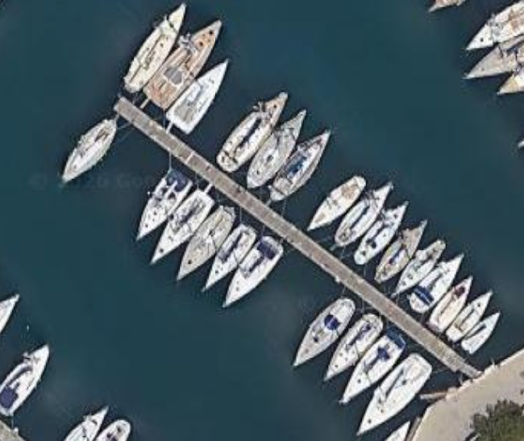


Conclusion
The work carried out aligns with the results reported in [1]. In addition, the confusion matrix shows a significant contribution on the main diagonal. This denotes a good classification capacity of the model for all classes. The choice of the number of descriptors with which to build the codebook significantly influences the classification performance.
Possible improvements
SIFT descriptors are constructed by analyzing a patch around the identified keypoint. However, despite capturing some spatial information it is not enough. In addition, the BoVW approach will not take this into account regardless. Even in the BoW case, the position in which words appear in a document is not taken into account. So, as reported in [1], the Spatial Pyramid Matching technique could be employed. The idea is to divide the image into gradually denser grids and calculate a local BoVW histogram of the various regions and then recombine them with a weighted sum. Another alternative could be to concatenate a color information descriptor to the SIFT descriptor.
Test out of bounds
Screenshots were taken Punta Raisi and the pier of La Cala. Note: There is no limit to the number of SIFTs extracted per image during inference.

Slide 11
Bibliography
[1] Bag-Of-Visual-Words and Spatial Extensions for Land-Use Classification, Yi Yang and Shawn Newsam
[2] 8.2_Bag_of_Visual_Words.pdf
[3] bof_classification_winter.pdf
[4] A Performance Evaluation of Local Descriptors, Krystian Mikolajczyk and Cordelia Schmid
[5] Hands-On Machine Learning with Scikit-Learn, Keras, and TensorFlow
Disclaimer
Generative models such as Gemini and Claude have been used to:
Realization of the parts of code involving the matplotlib library Quickly interact with library documentation Pickle and numpy save options

